Slide 1
Neuralangelo
High-Fidelity Neural Surface Reconstruction

Slide 2
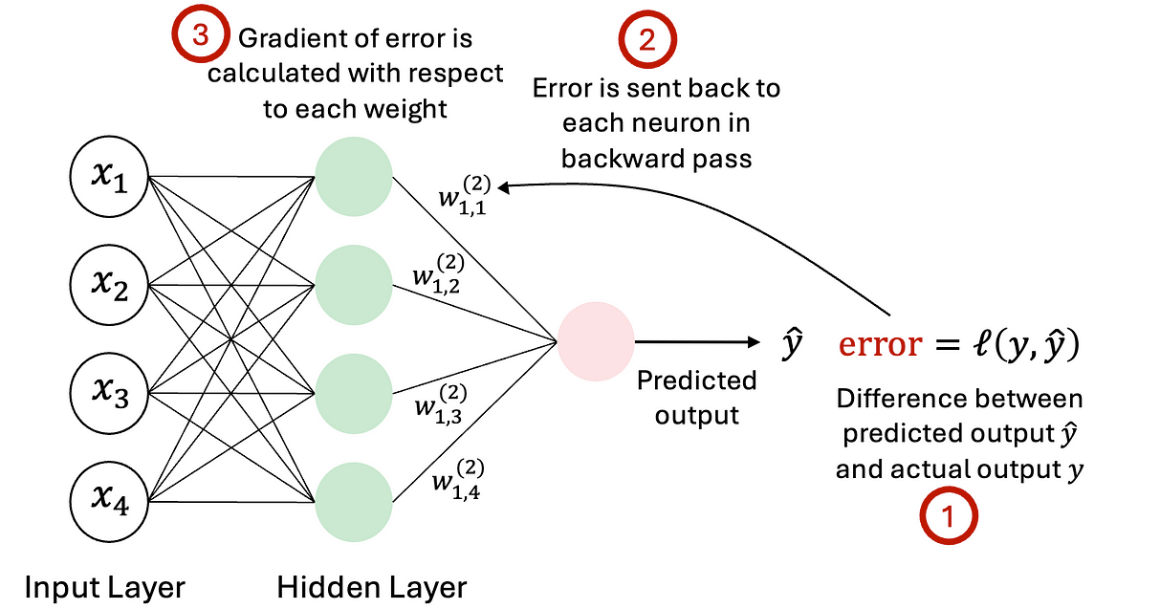
Seminar Summary
ICP
LiDAR SLAM
Visual
SLAM
Probabilistic
SLAM
3D Reconstruction
- Point Registration (Association)
- Feature extraction
- Probability
- AI(Neural Network)
- Trajectory
- Sensor Odometry
- Camera Tracking
- SLAM

Slide 3
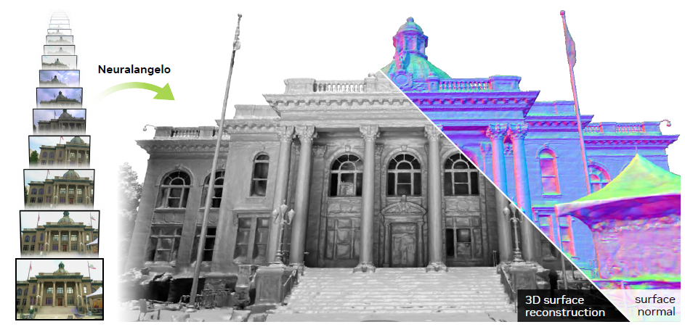
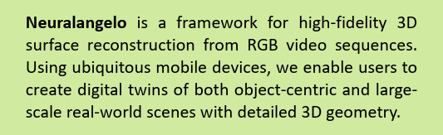
Neuralangelo
Li, Zhaoshuo, Müller, Thomas, Evans, Alex, Taylor, Russell H., Unberath, Mathias, Liu, Ming-Yu, and Lin, Chen-Hsuan. "Neuralangelo: High-Fidelity Neural Surface Reconstruction."IEEE Conference on Computer Vision and Pattern Recognition (CVPR), 2023

Slide 4
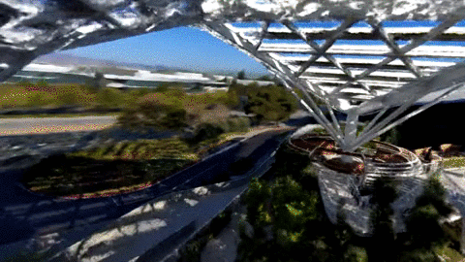
High-Fidelity Neural Surface Reconstruction

Slide 5
참고자료
논문 설명페이지 - https://research.nvidia.com/labs/dir/neuralangelo/
https://ozgungenc.substack.com/p/neural-graphics-neuralangelo
SDF 와 Eikonal equation https://velog.io/@gjghks950/SDF-Signed-Distance-Function-%EC%99%80-Eikonal-Equation
오늘의집 테크블로그 https://www.bucketplace.com/post/2023-08-10-neural-rendering-%EA%B0%9C%EB%B0%9C-%EC%9D%B4%EC%95%BC%EA%B8%B0-1-%EA%B3%B5%EA%B0%84%EC%9D%98-%EA%B8%B0%EB%A1%9D/

Slide 6
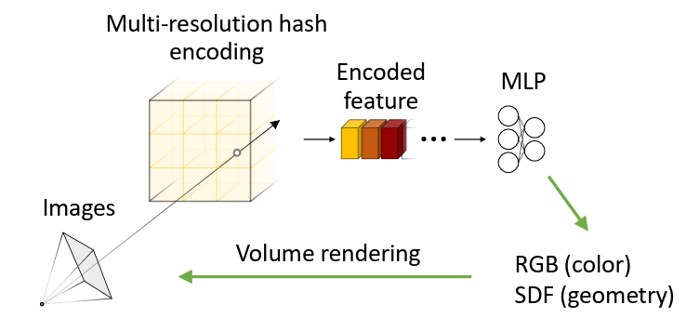
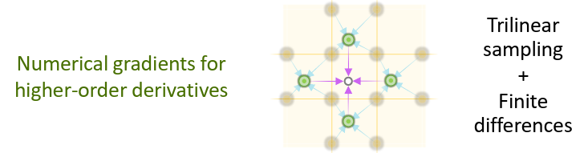
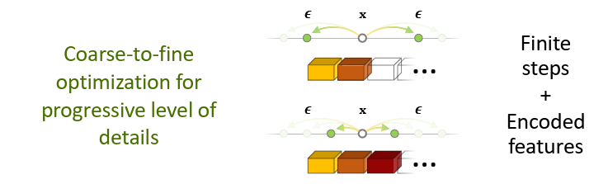

Summary

Slide 7
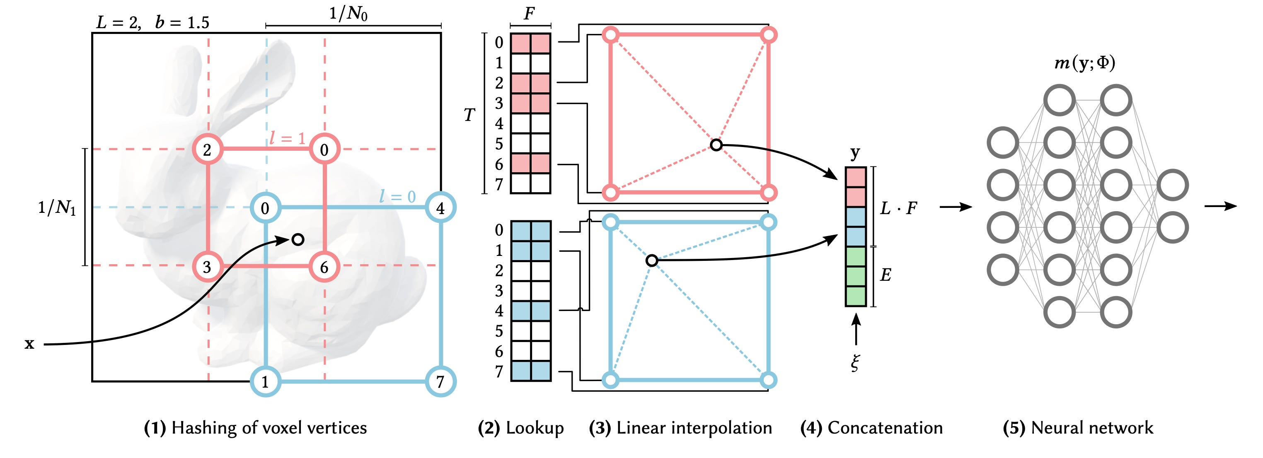
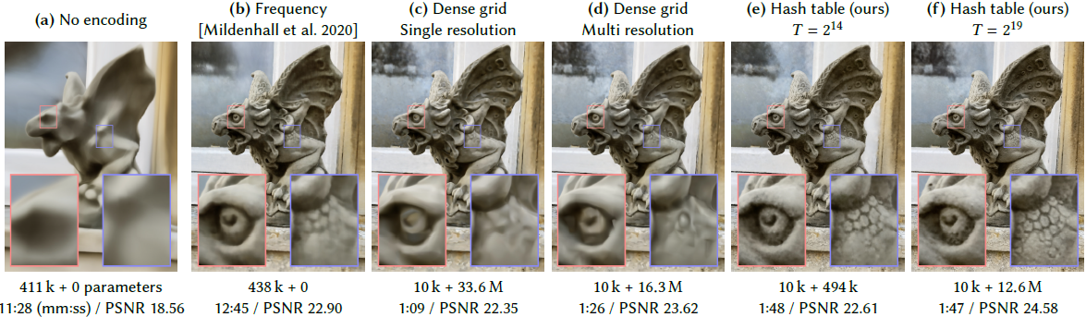
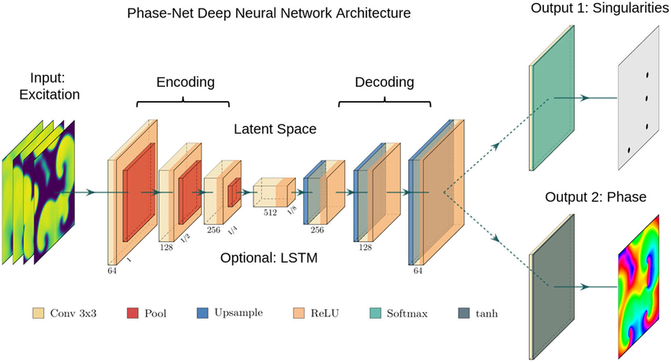
Multi-resolution hash encoding
Müller, Thomas, et al. "Instant neural graphics primitives with a multiresolution hash encoding." ACM transactions on graphics (TOG) 41.4 (2022): 1-15.
Network
가중치
Hash grid

Slide 8
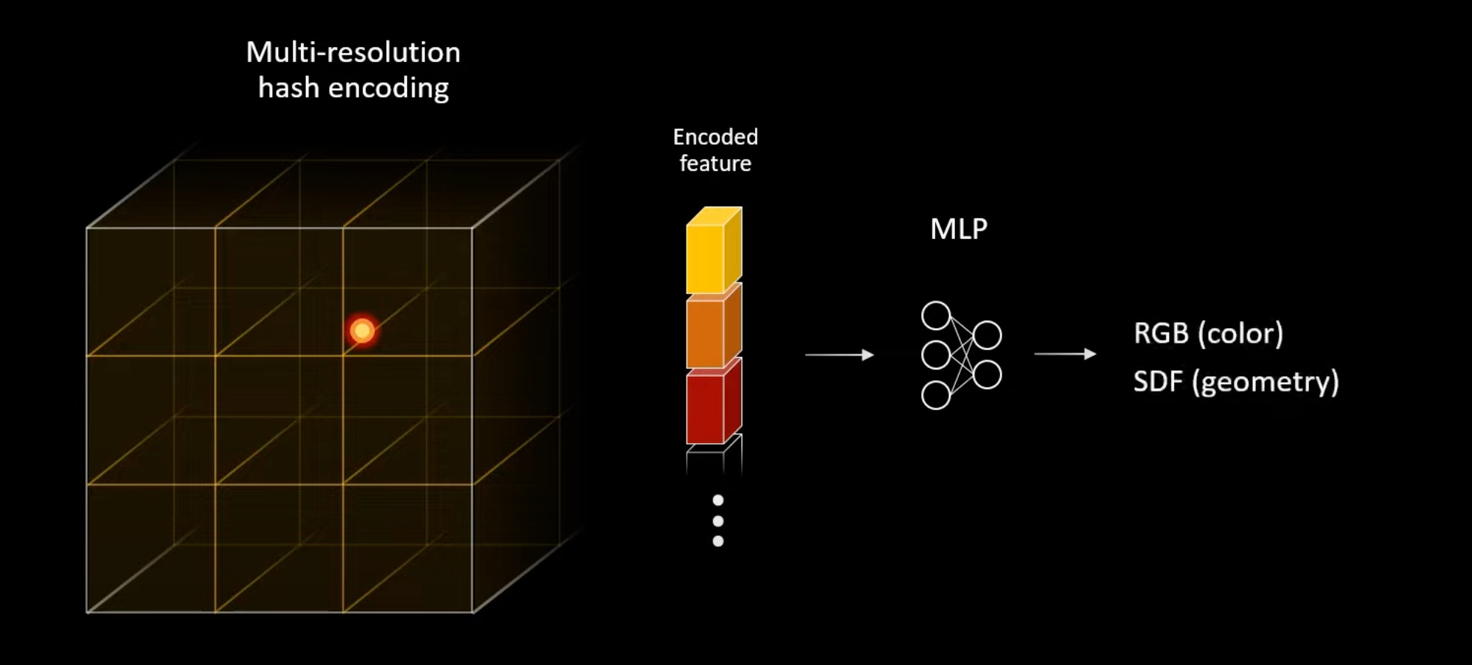
Multi-resolution hash encoding
Surface Normal

Slide 9
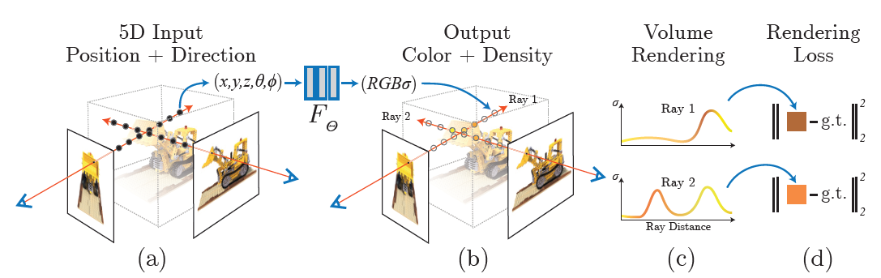
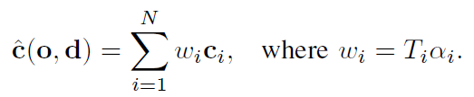
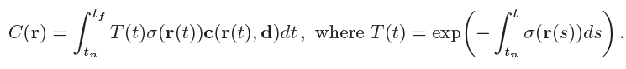
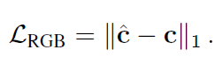
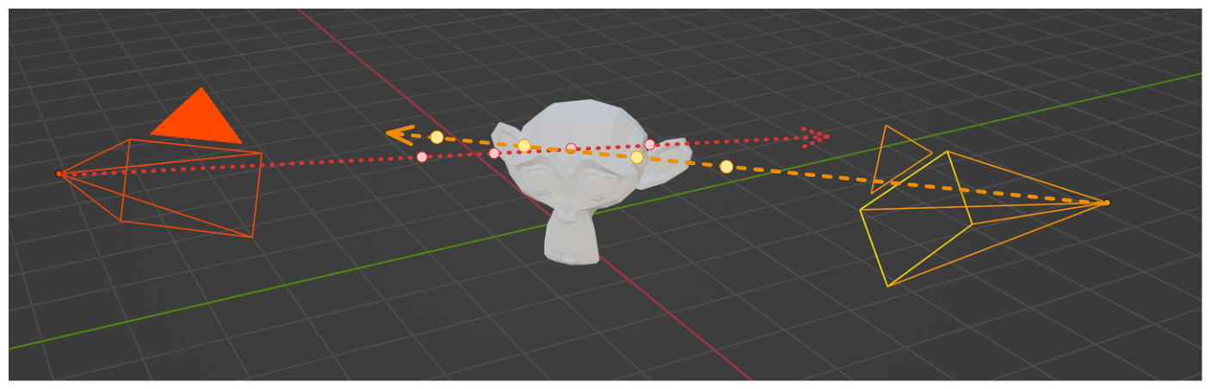
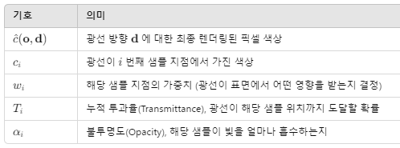
Neural Radiance Fields (NeRF)

Slide 10
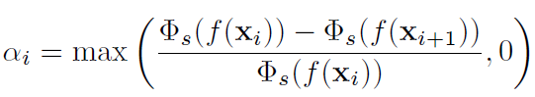
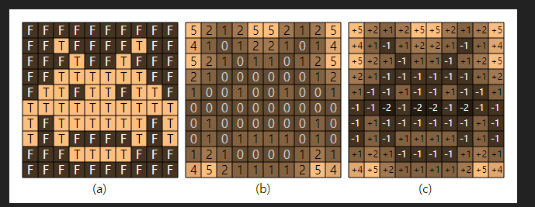
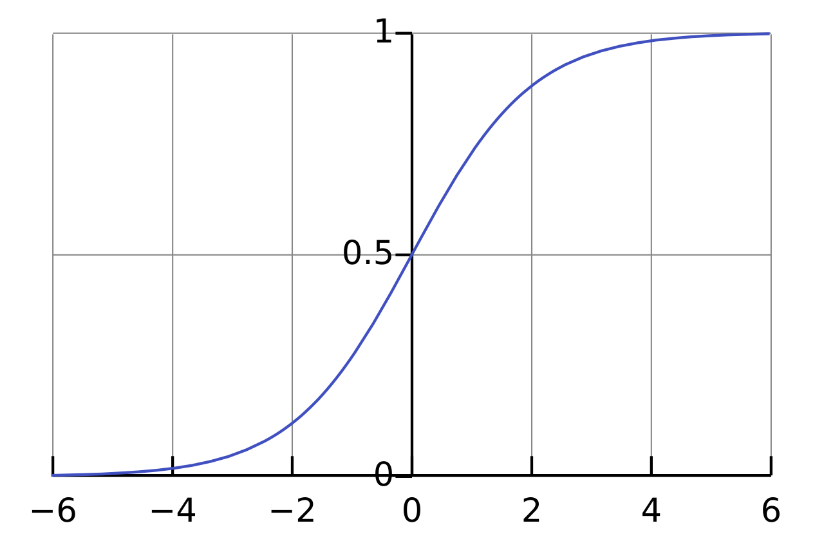
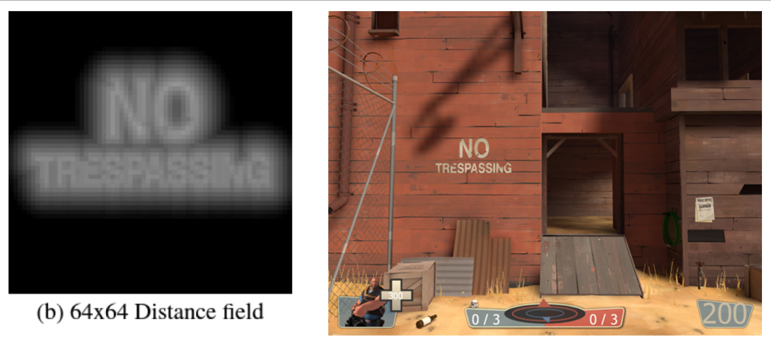
Signed Distance Function
https://do-workspace.tistory.com/51

Slide 11
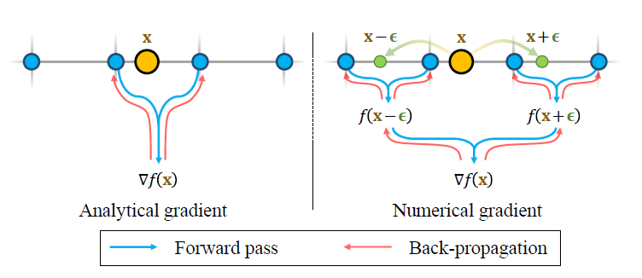
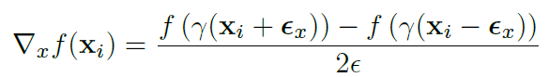
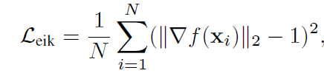
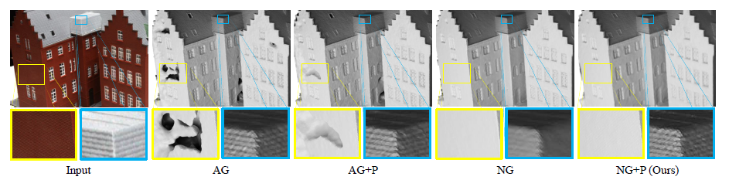
Numerical Gradient Computation

Slide 12
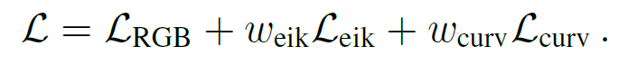
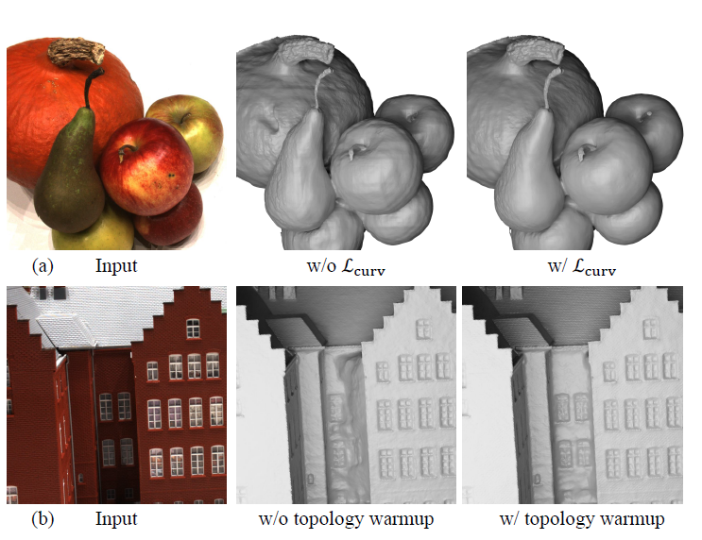
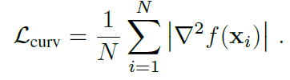
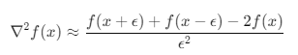
Optimization
■ Curvature Regularization
■ Topology Warm-up
초기 SDF 함수를 Sphere 로 가정
짧게 학습 후 점진적으로(Linearly) w_curv 의 값을 증가시킴.

Slide 13
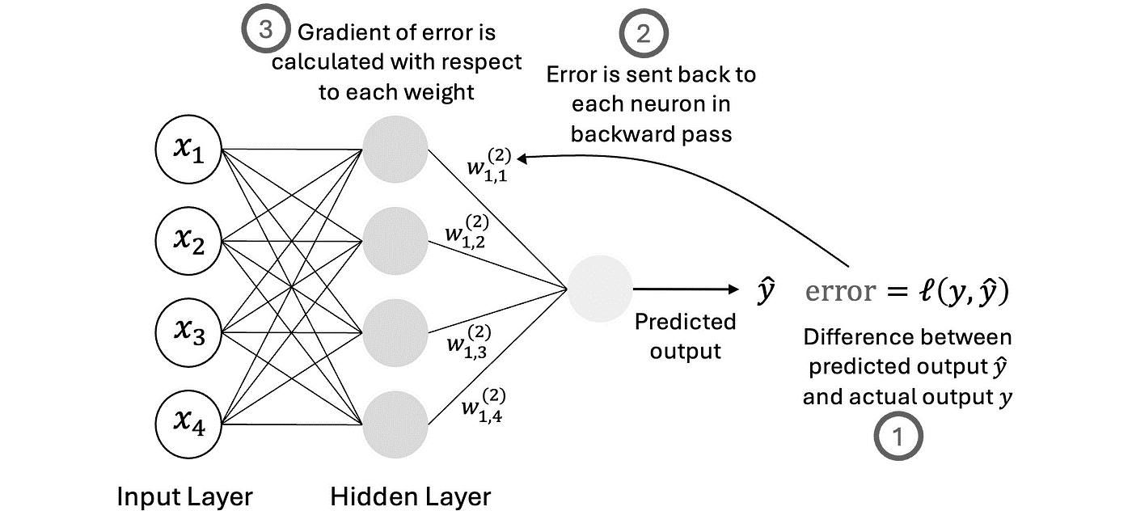
Neural Network
RGB
SDF
Multi-resolution
hash encoding

Slide 14
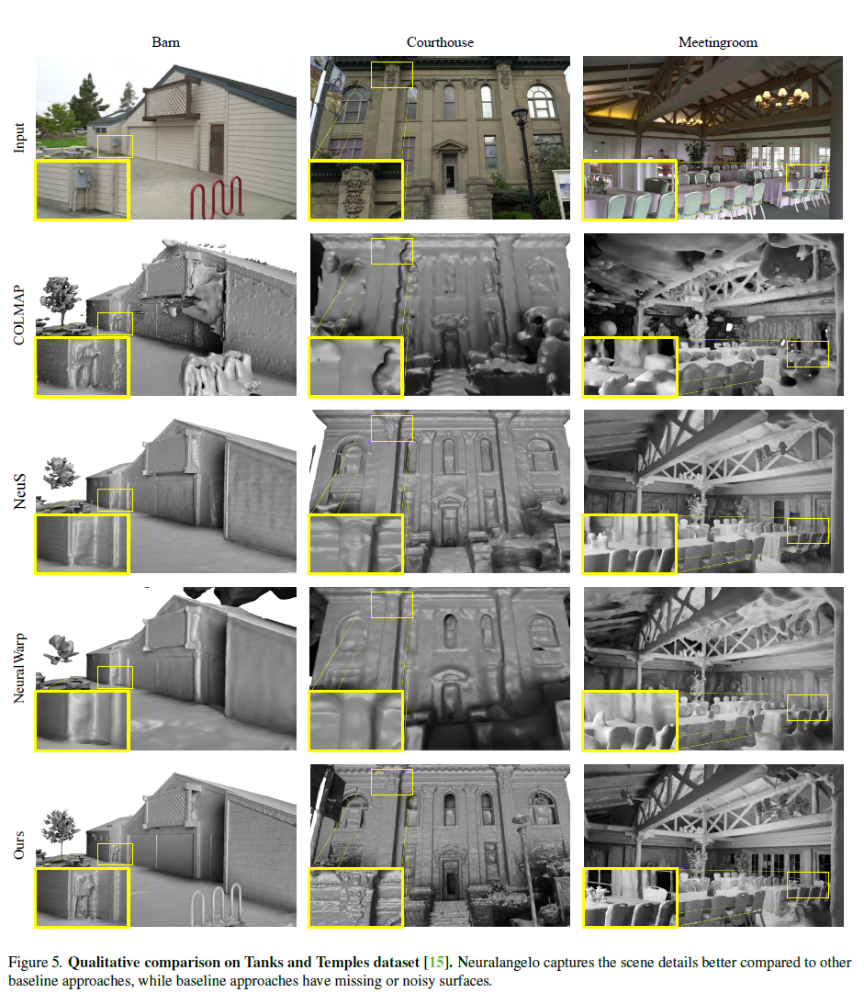
Experiment

Slide 15
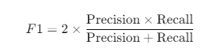
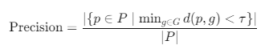
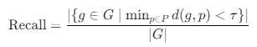
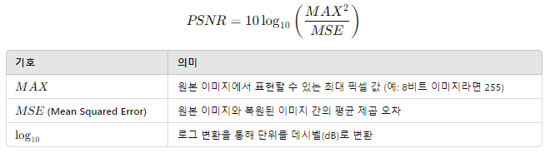
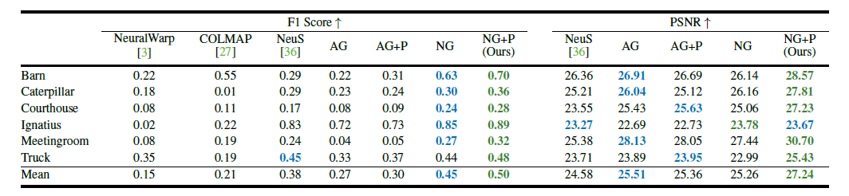
Experiment
F1 Score
PSNR

Slide 16
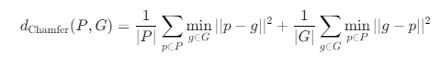
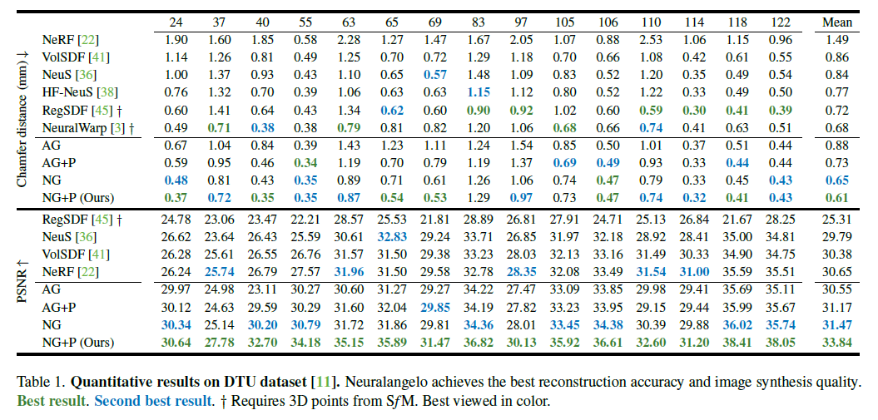
Experiment
■ Chamfer distance

